Slide 1


4th Grade
Biography Project
2018-20

Slide 2
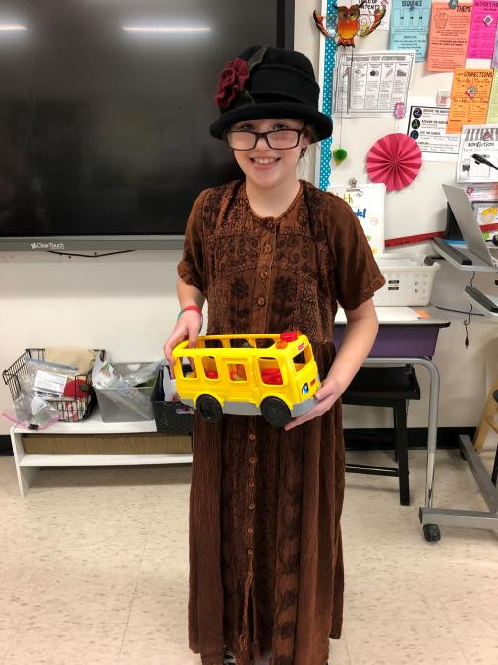
Rosa Parks

Slide 3
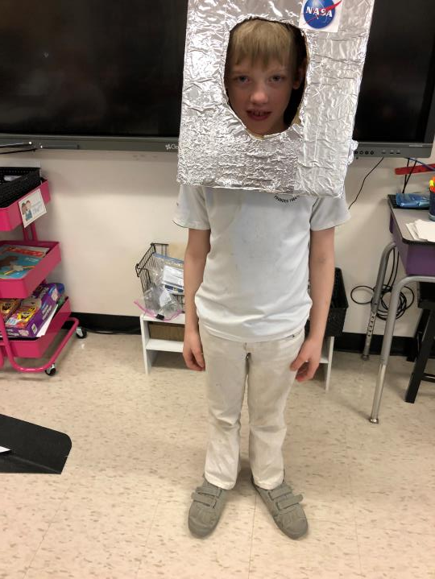
Neil Armstrong

Slide 4
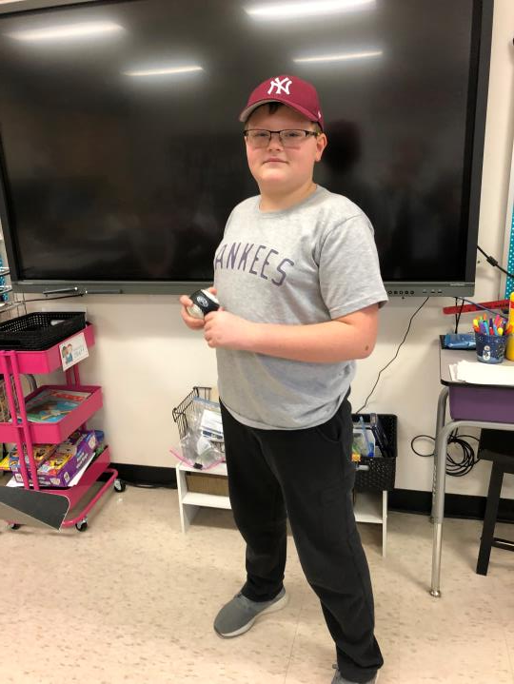
Babe Ruth

Slide 5
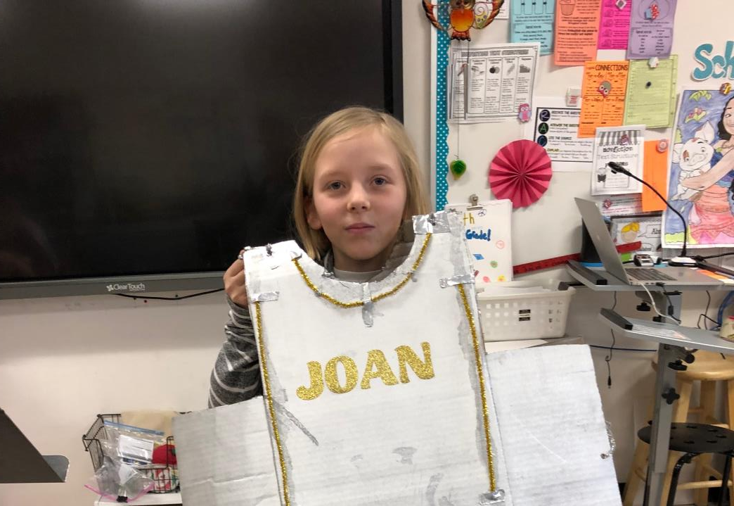
Of Arc

Slide 6
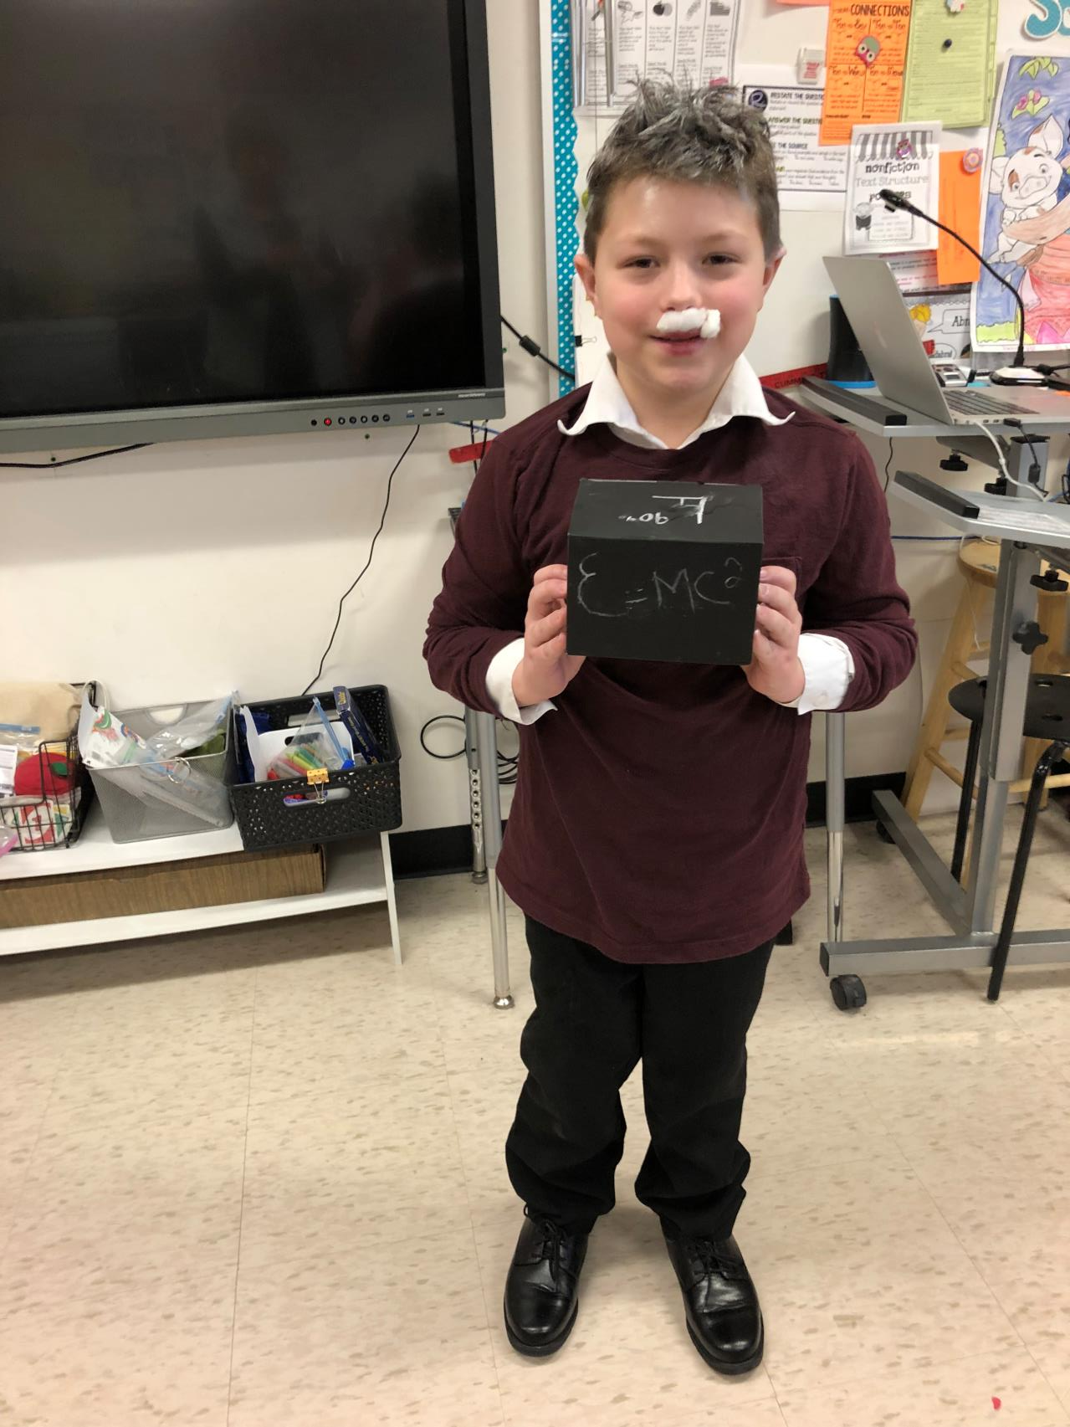
Albert Einstein

Slide 7
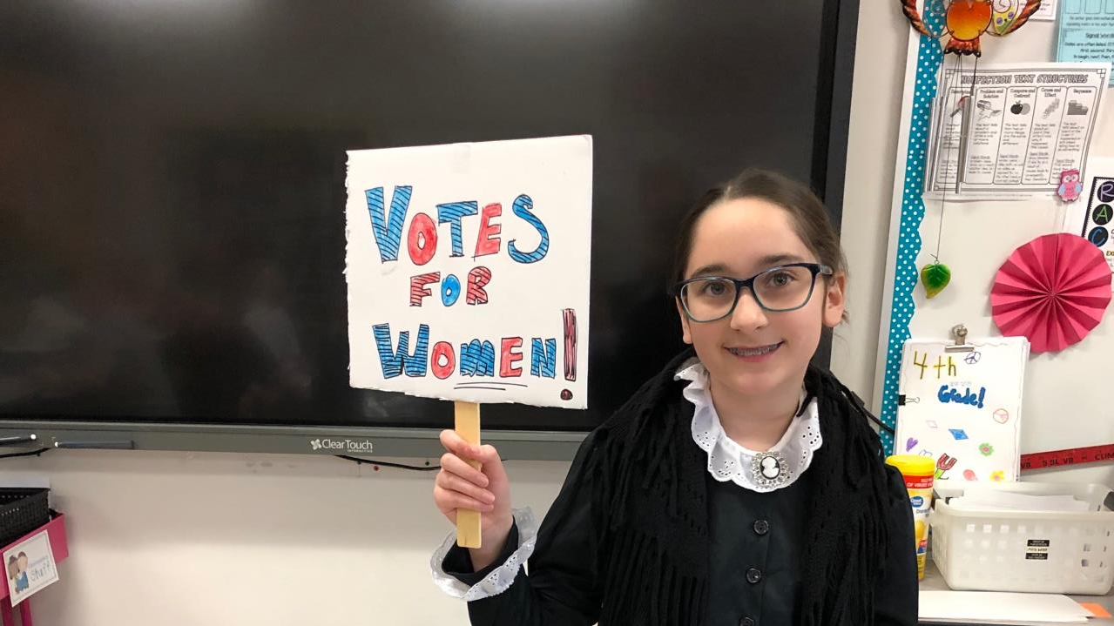
Susan B. Anthony

Slide 8
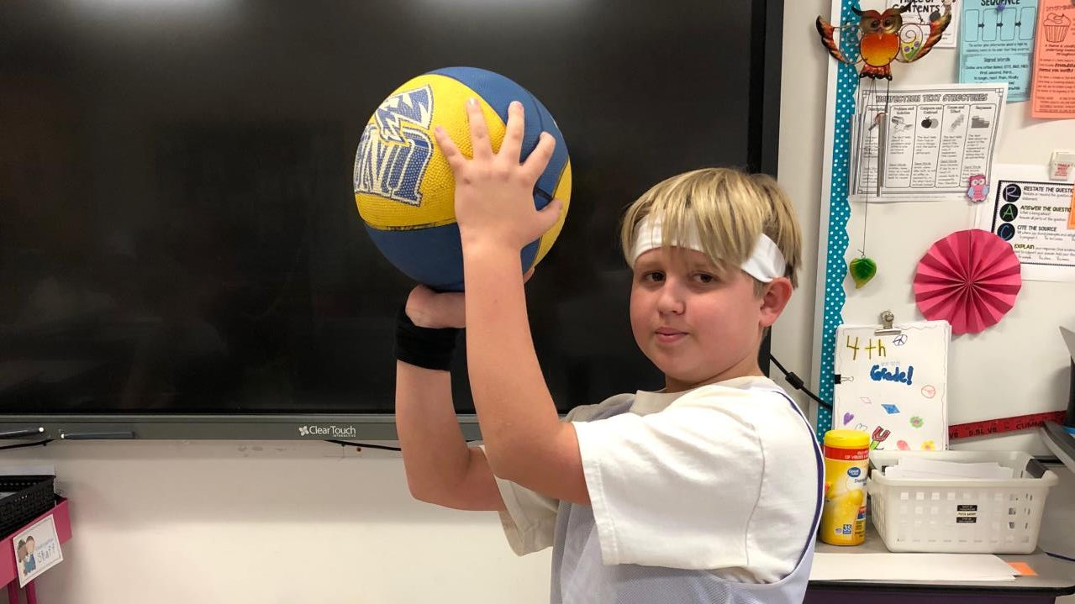

Slide 9
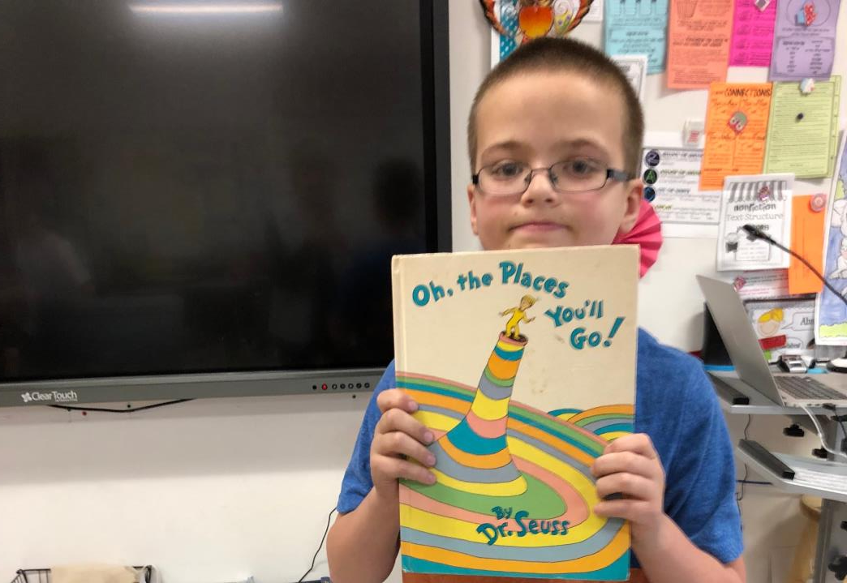


Slide 10
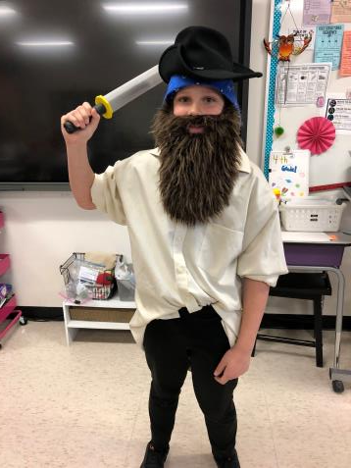
Blackbeard

Slide 11
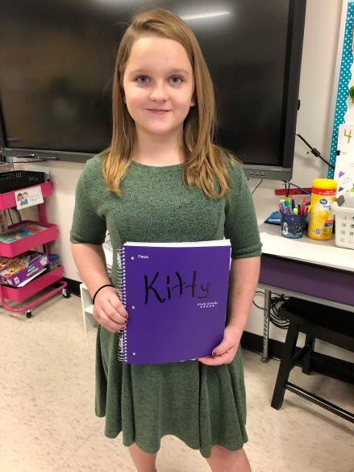
Anne Frank

Slide 12
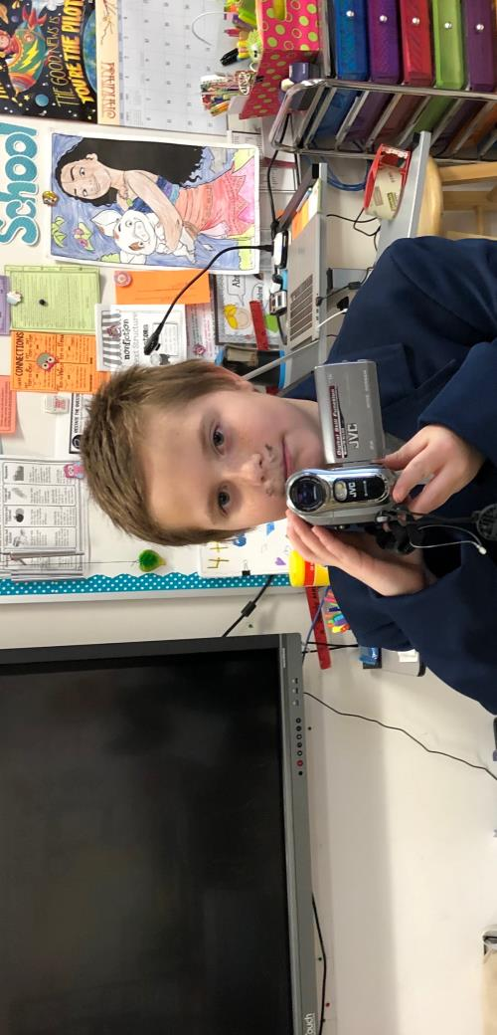
Walt Disney

Slide 13
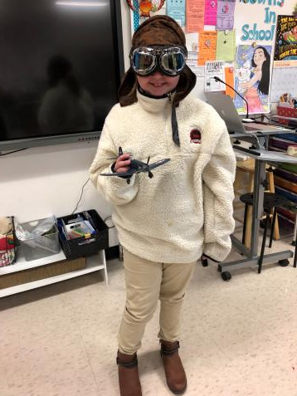
Amelia Earhart

Slide 14
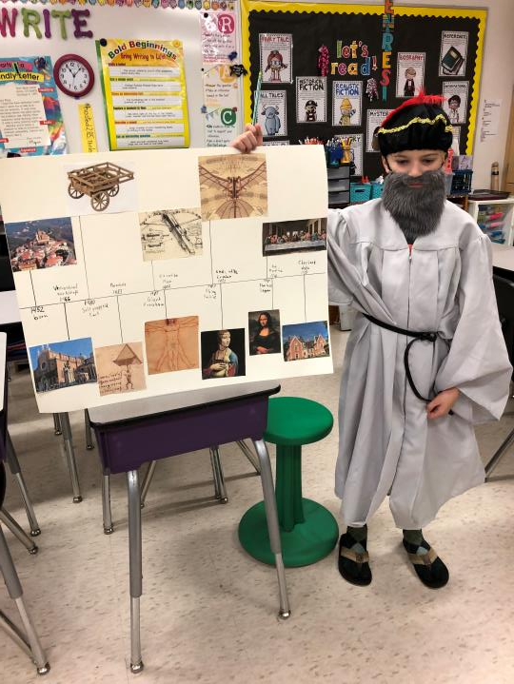
Leonardo da Vinci

Slide 15

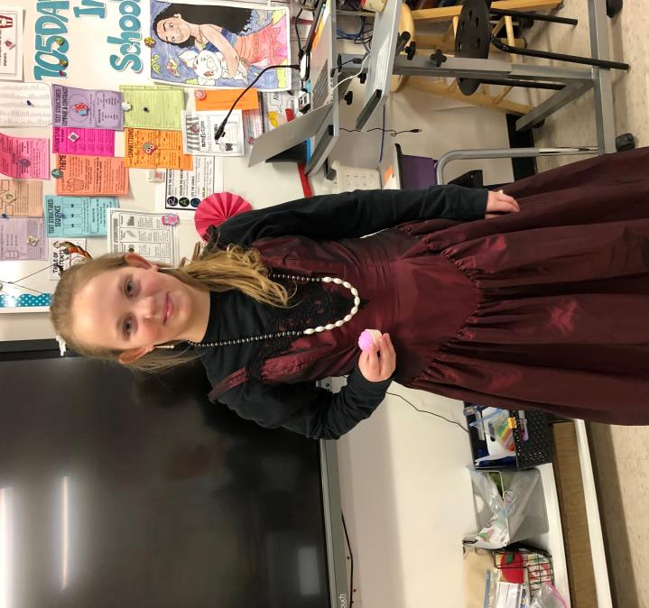
Marie Antoinette
“Let them eat cake”

Slide 16
The End…

